Slide 1
NVR debug method

Slide 2
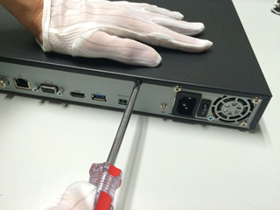
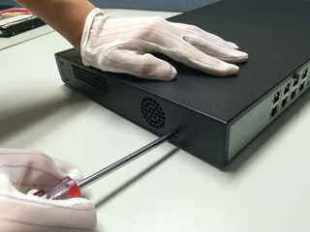
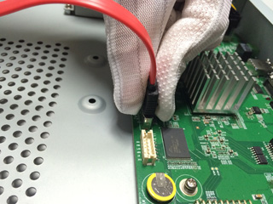
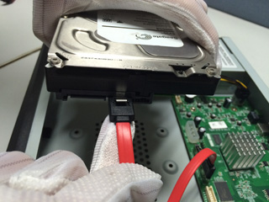
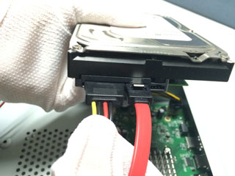
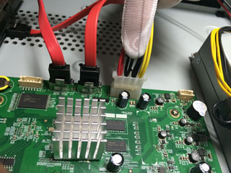
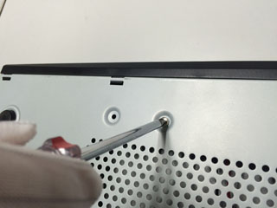
NVR adjustment
How to install the HDD.
1. Unscrew the screws on the back and sides of the chassis and remove the cover.
2. Connect one end of the hard disk data cable to the SATA port on the NVR motherboard and the other end to the hard disk.
3. Connect the hard disk power cord to the SATA connector on the NVR motherboard and the other end to the hard disk.
4. Secure the hard disk screws on the bottom of the NVR chassis, cover the upper
cover of the chassis, and fasten it with screws.

Slide 3
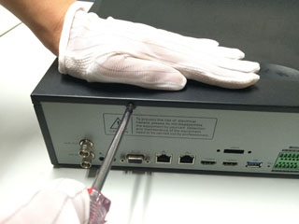
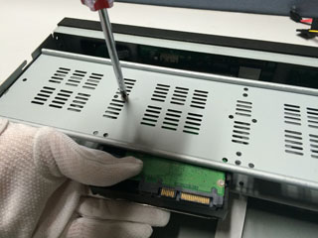
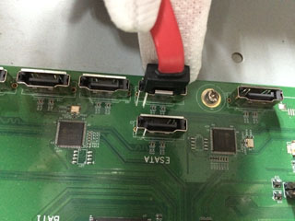
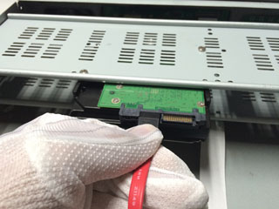
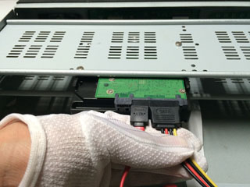
NVR adjustment
How to install the HDD.
1. Unscrew the back of the chassis, remove the cover, and secure the hard disk drive to the chassis hard drive bracket
2. Connect one end of the hard disk data cable to the SATA port of the NVR motherboard and the other end to the hard disk.
3. Connect the power cable to the hard disk, cover the top cover of the chassis, and fasten it
with screws.

Slide 4
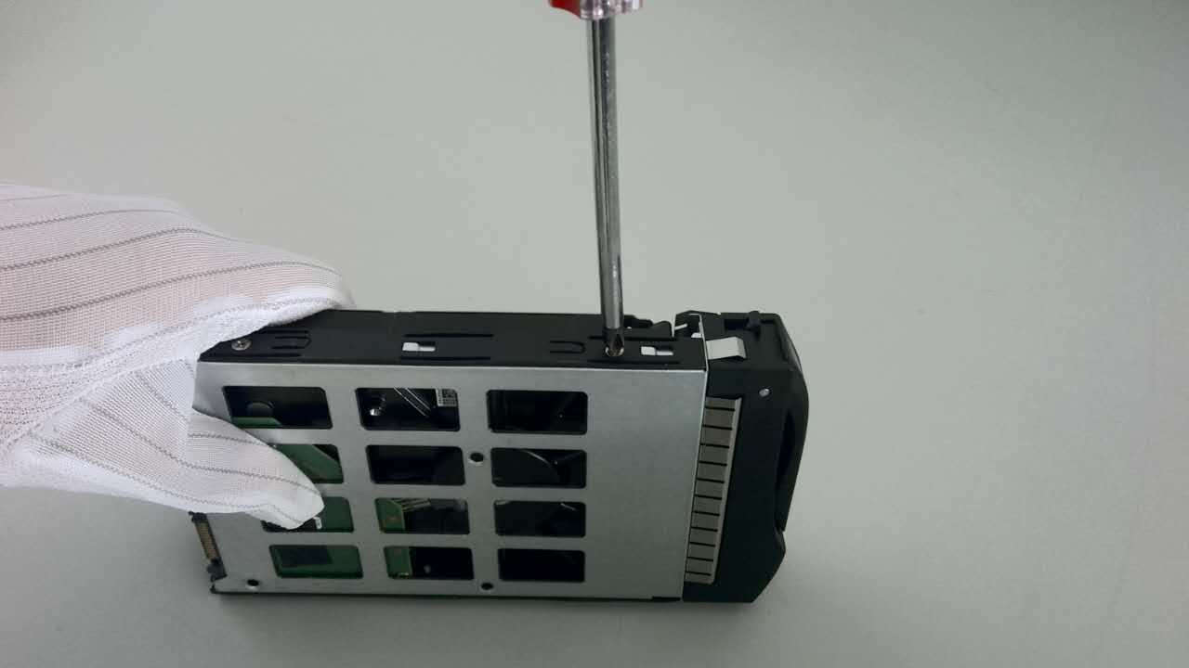
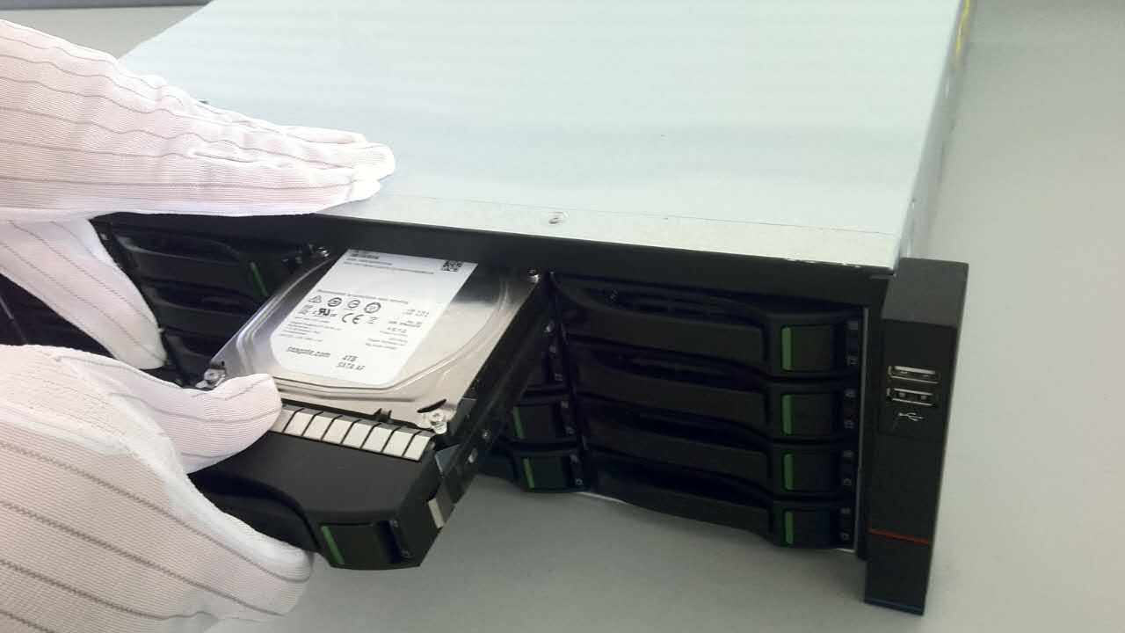
NVR adjustment
How to install the HDD.
1, Install the hard disk fixing screws and insert the corresponding hard disk slots on the front panel.
2, push the hard disk into the corresponding hard disk slot, close the front panel.

Slide 5
NVR adjustment
The first time using NVR, don’t know how to operate?
Use Boot Wizard !
NVR complicated function settings become simple, very fast!

Slide 6
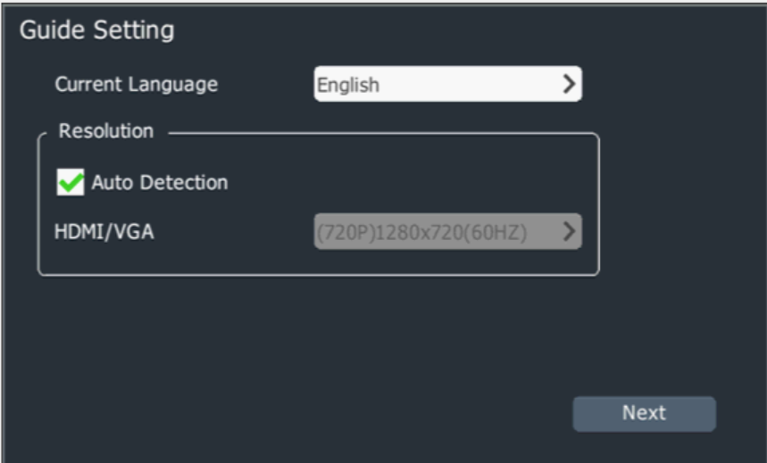
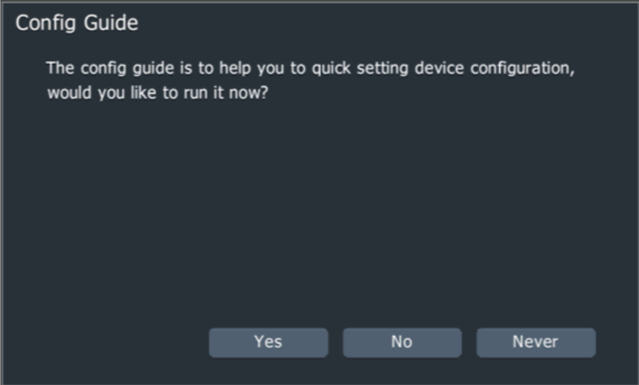
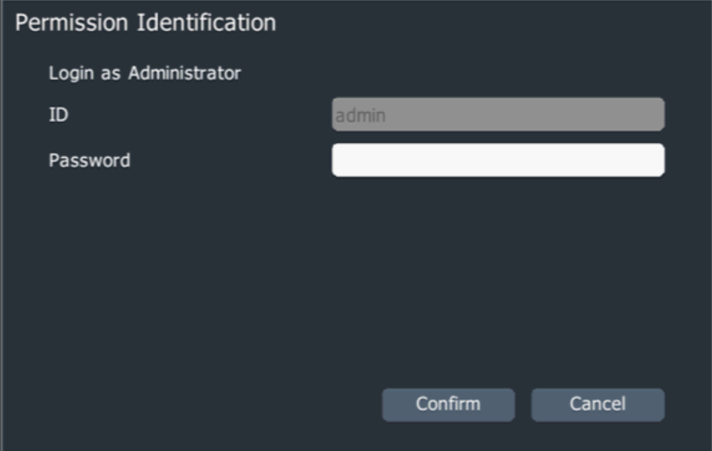
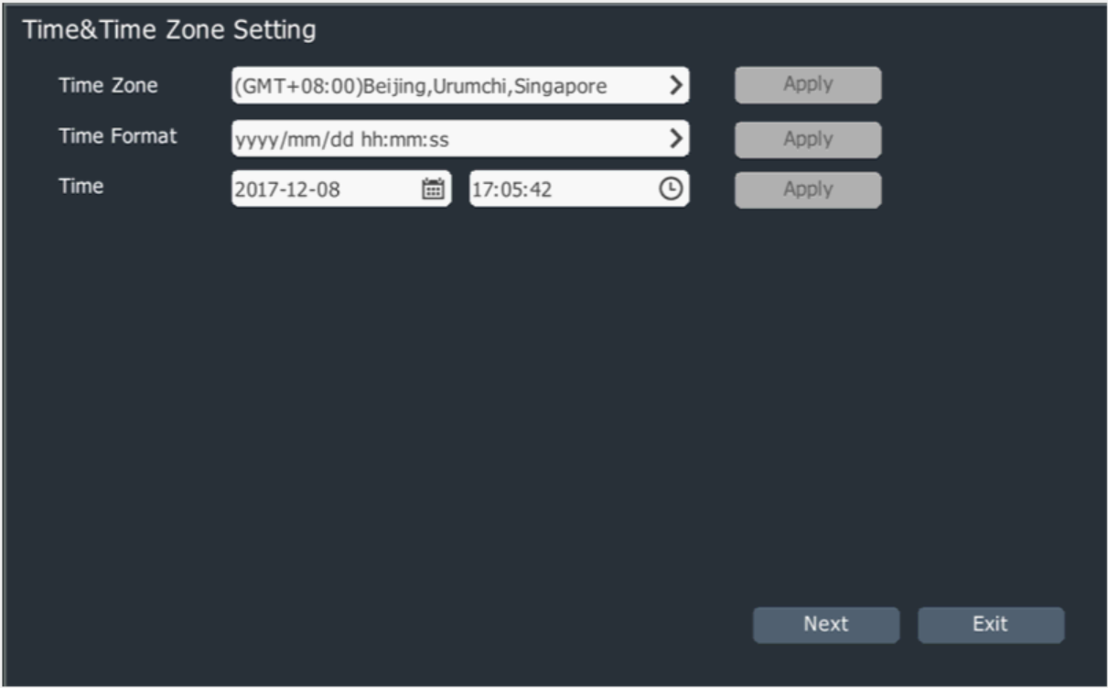
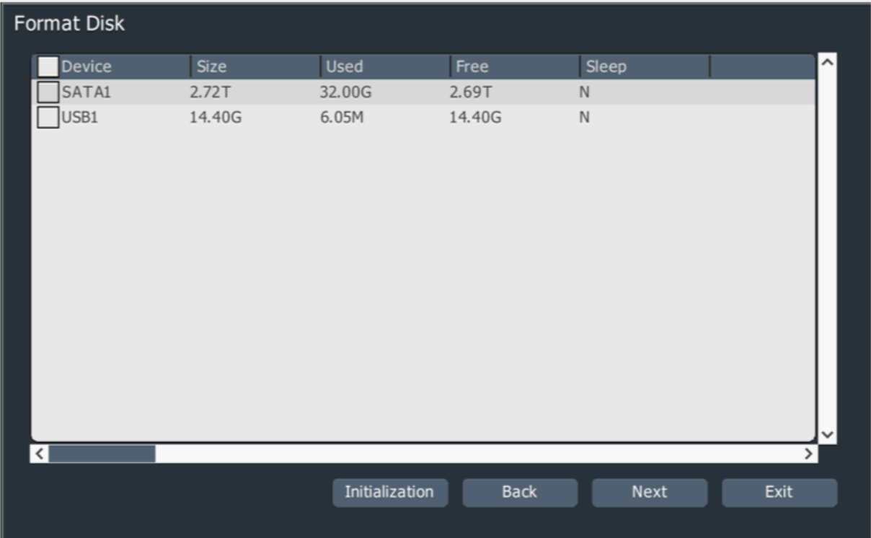
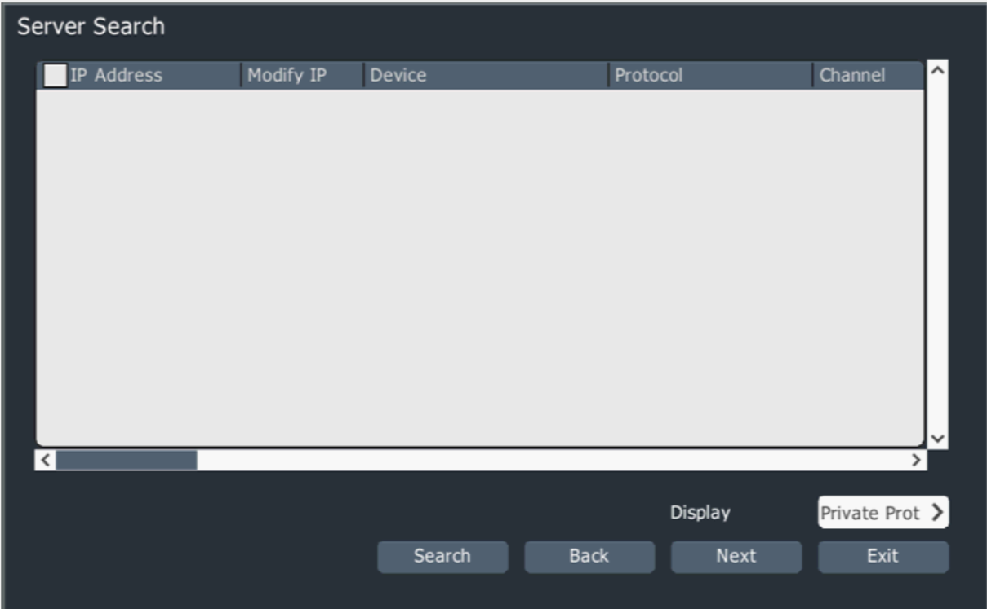
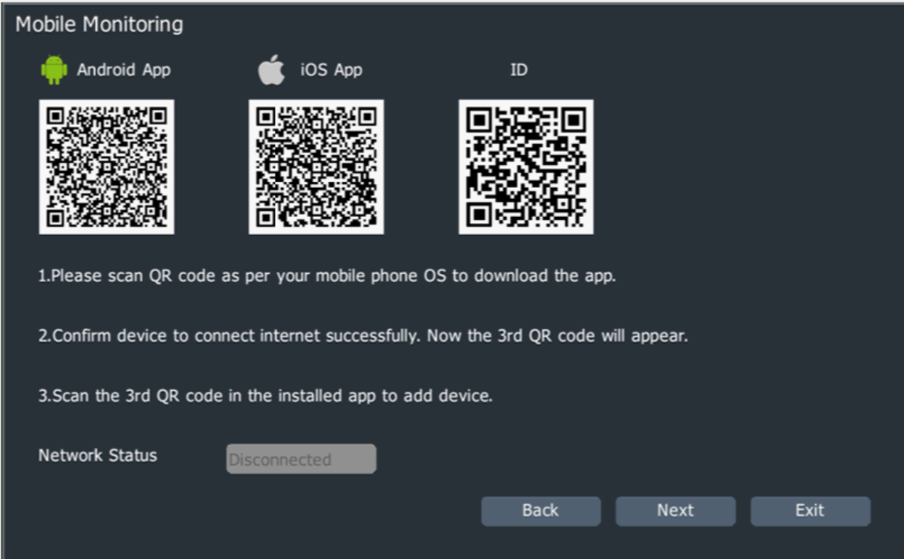
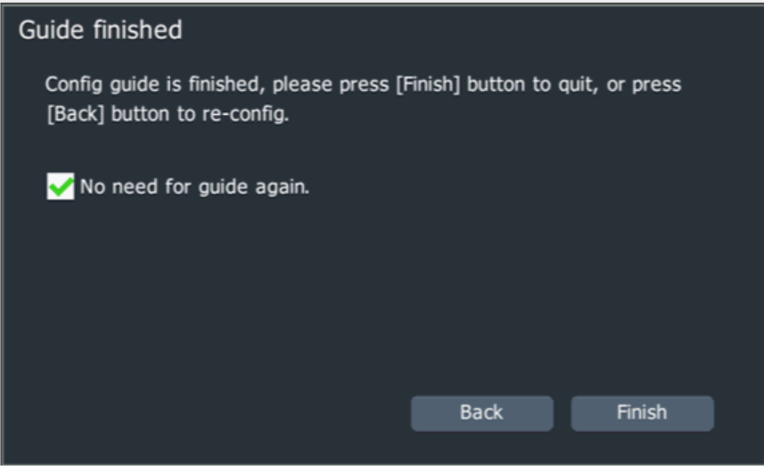

Slide 7
NVR adjustment
Network card 1 configuration
Network card 2 configuration
Network card 3 configuration
NVR Network card configuration

Slide 8
NVR adjustment
Network card 1 configuration
Obtain IP address automatically
Obtain an IP address from DHCP in the network automatically.
Manually obtain the IP address Need to specify the device's IP address, subnet mask, gateway and other information. Click the "Apply" button.

Slide 9
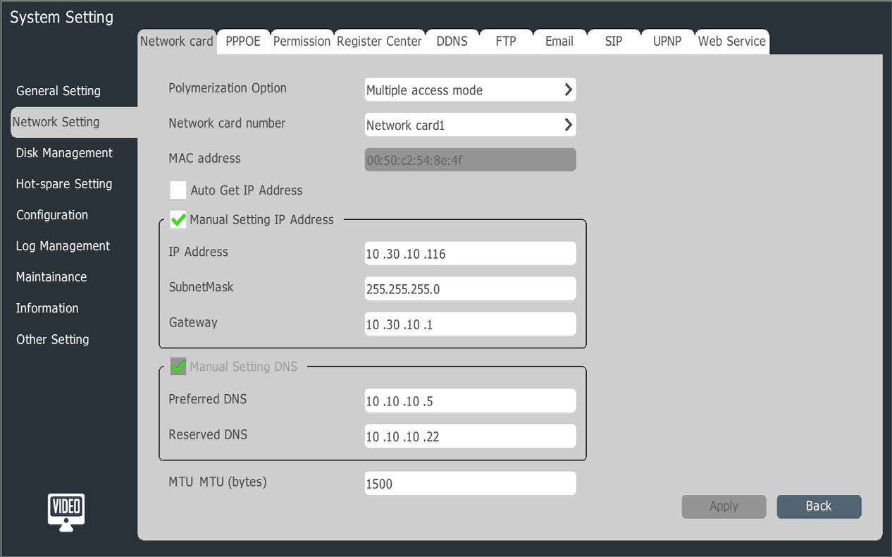
NVR adjustment

Slide 10
NVR adjustment

Slide 11
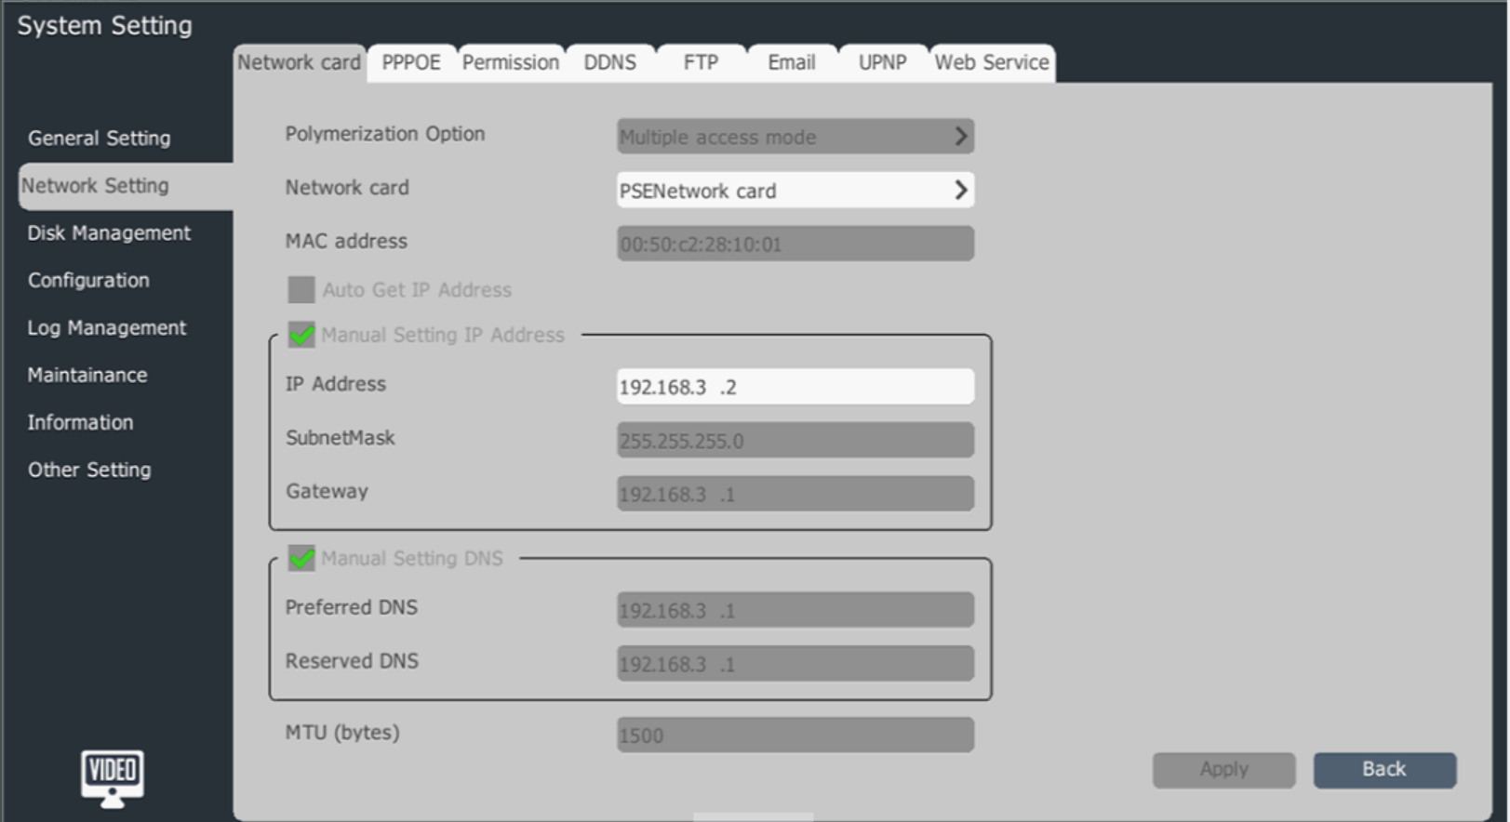

Slide 12
NVR adjustment
One key add
Search to add
Add manually
How NVR adds digital channels

Slide 13
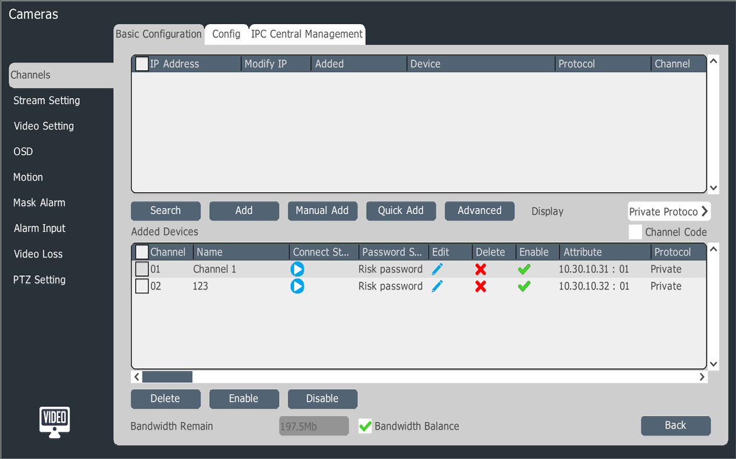
One key add
NVR adjustment
Auto search inside the network camera added to the digital channel

Slide 14
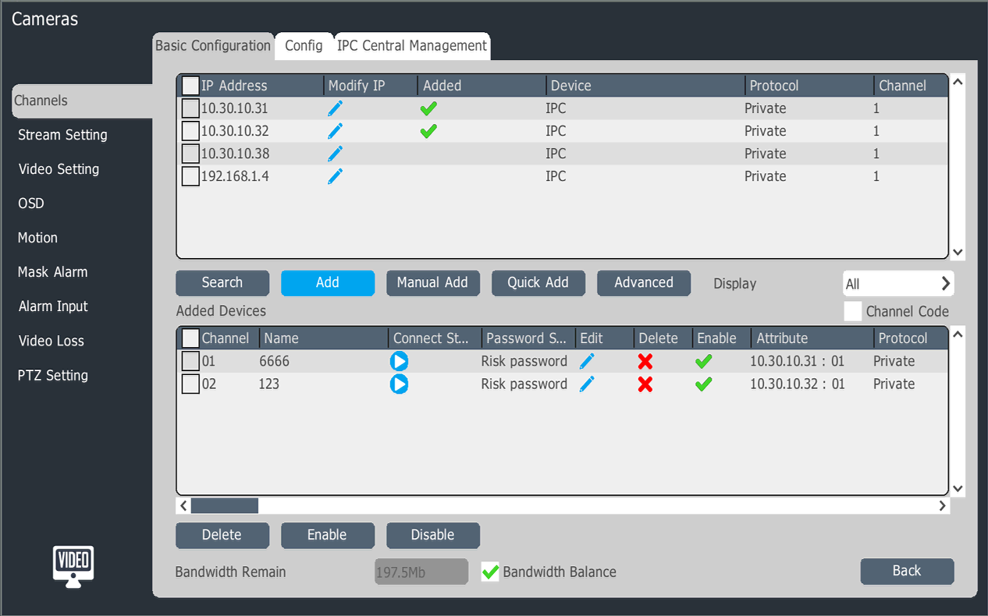
NVR adjustment
Search to add
Notes:
搜索添加通道，点击“搜索”，搜索完成后，双击设备IP即可添加

Slide 15
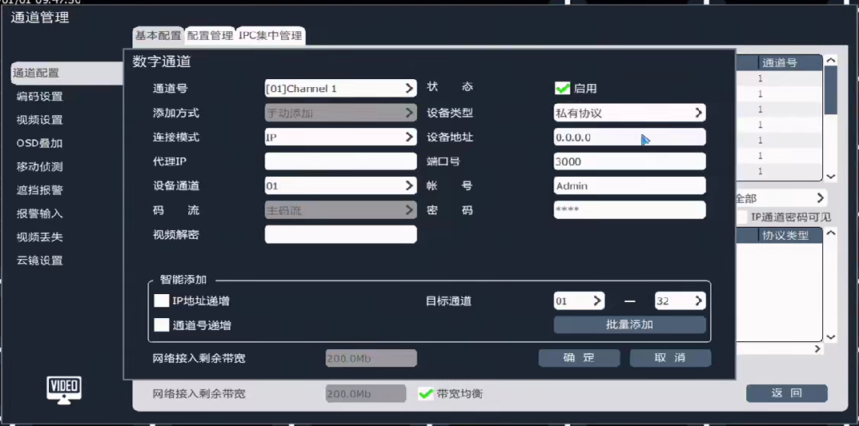
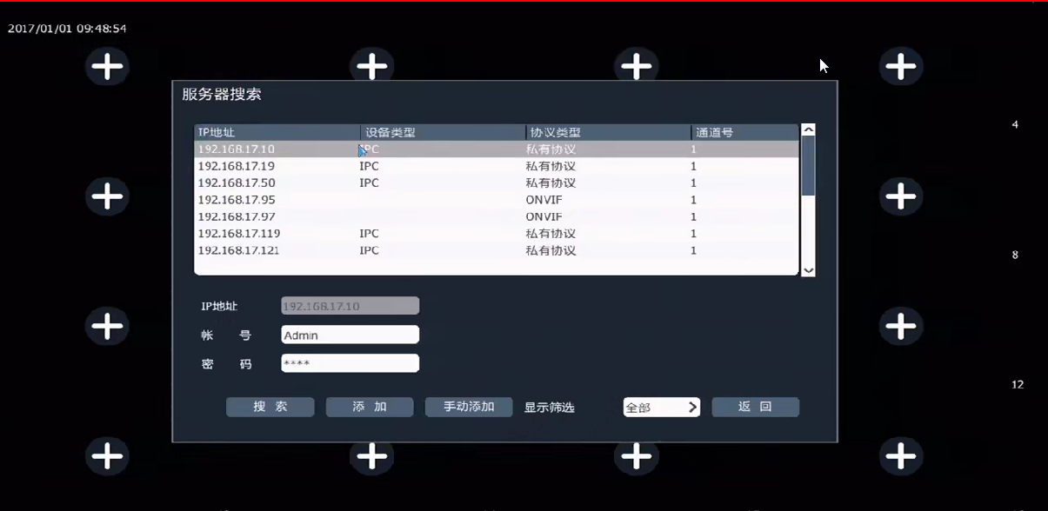
NVR adjustment
Add manually
Notes:
手动添加通道：一般情况下只需要修改“通道号”“状态”“设备地址“即可。

Slide 16
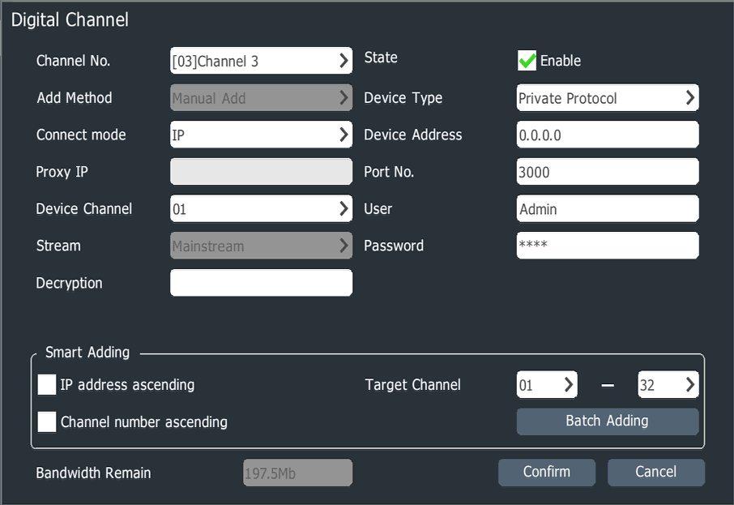
NVR adjustment
Manual add other brand
camera
Notes:
手动添加其他类型通道,在NVR中可以添加ONVIF及RTSP流通道。

Slide 17
Basic setting
Upgrade setting
record strategy
NVR record setting
NVR adjustment

Slide 18
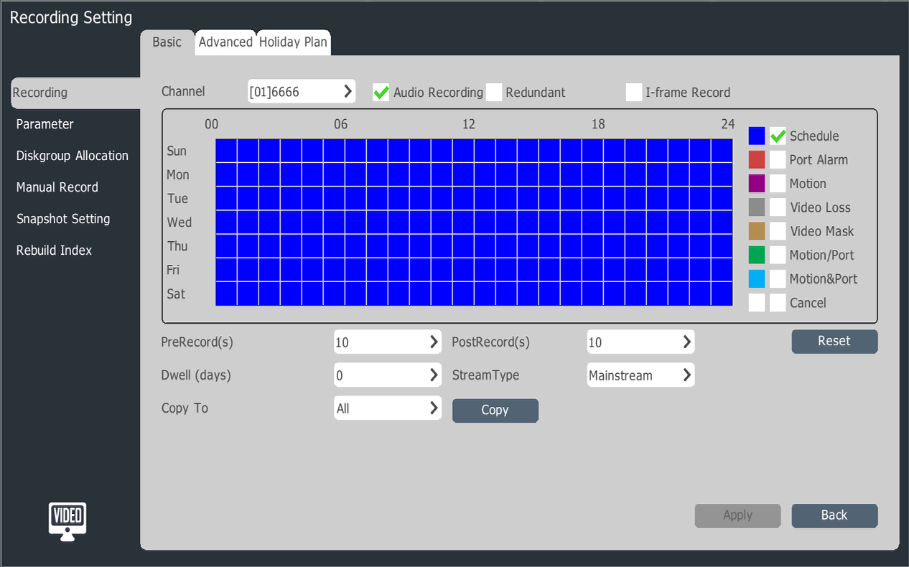
NVR adjustment
Basic setting
Set the video channel, select whether to record audio, video type, recording time, pre-recorded delay time, video stream and other parameters. Video duration can be saved by day, 0 means do not limit the number of days saved

Slide 19
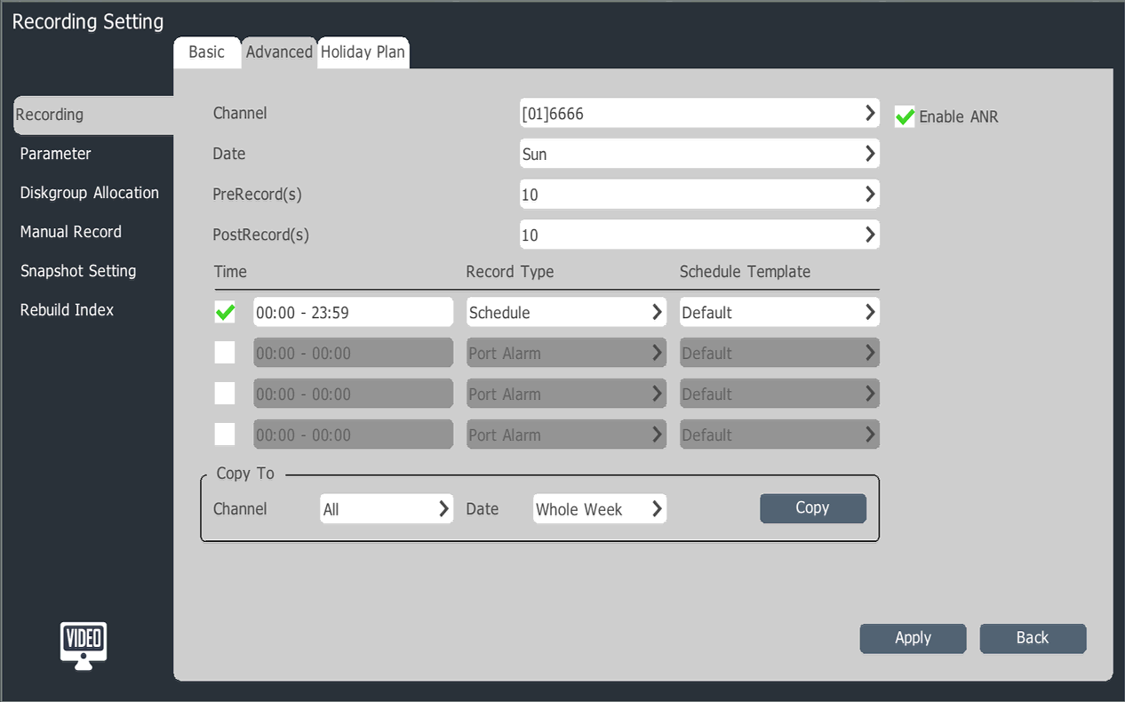
NVR adjustment
Upgrade setting
Set channel for recording, whether to enable ANR function, pre-record delay time, record time period, record type and other parameters

Slide 20
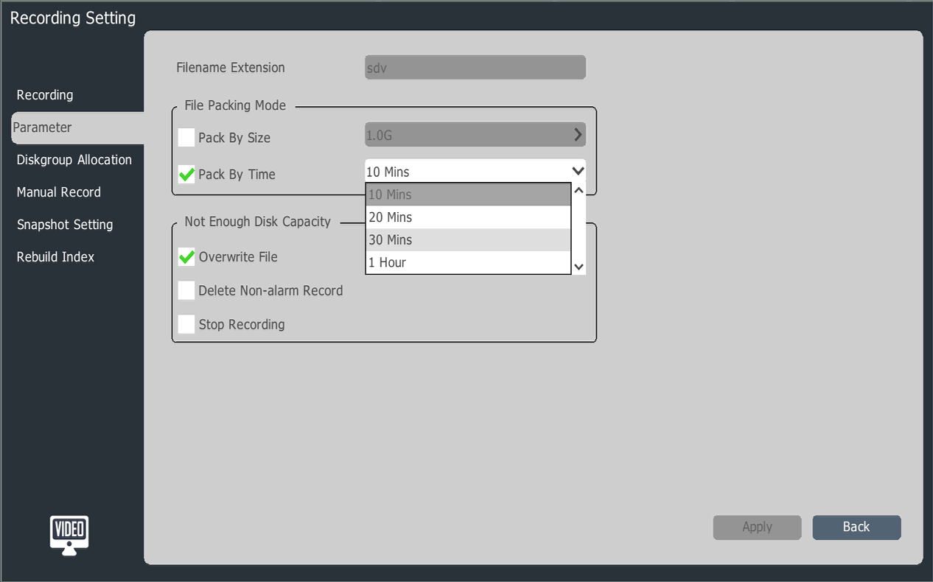
NVR adjustment
Record strategy
Set the video packaging method and the lack of disk space when the system processing

Slide 21
NVR adjustment
Disk group settings
The performance of the disk itself limits the speed of writing, how to improve the hard disk read and write efficiency
Disk grope
Disk Group: The hard disk attached to the NVR is divided into multiple disk groups. You can specify the disk group of the video files for each channel.

Slide 22
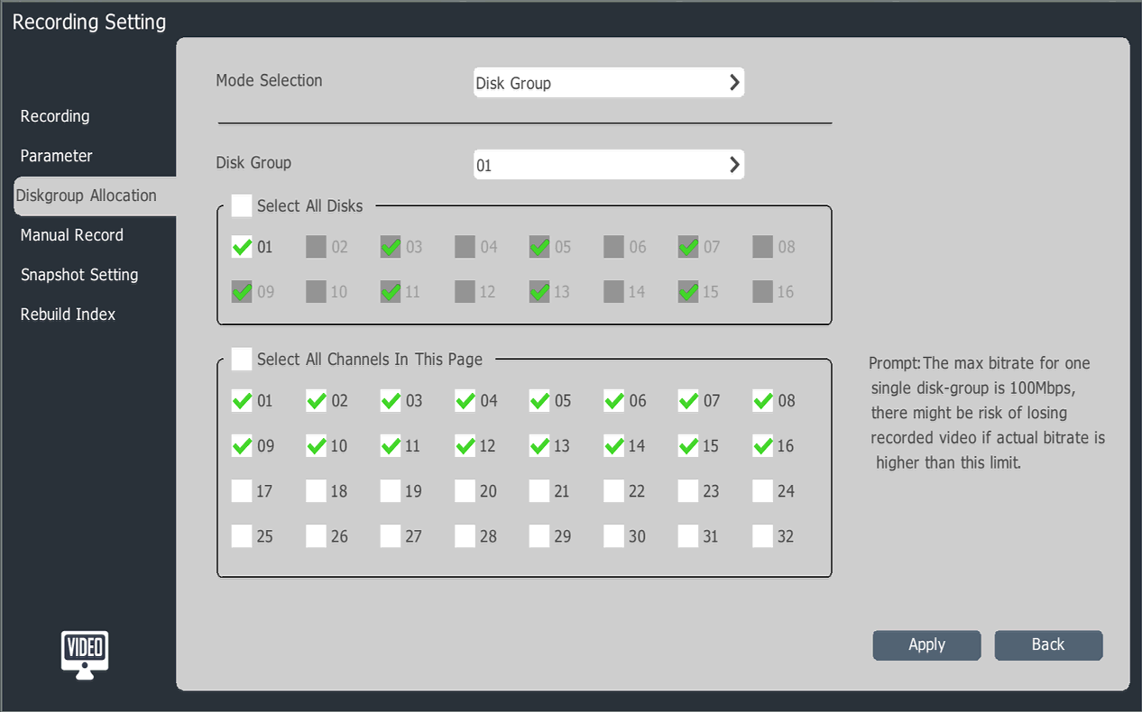
NVR adjustment
Notes:
NVR最大支持8个盘组设置

Slide 23
NVR adjustment
review

Slide 24
NVR adjustment
Normal review
Playback process, the mouse at any point in the progress of the stay, change the time point of the preview screen immediately appear in front of you, up to 16 pictures can be played back.

Slide 25
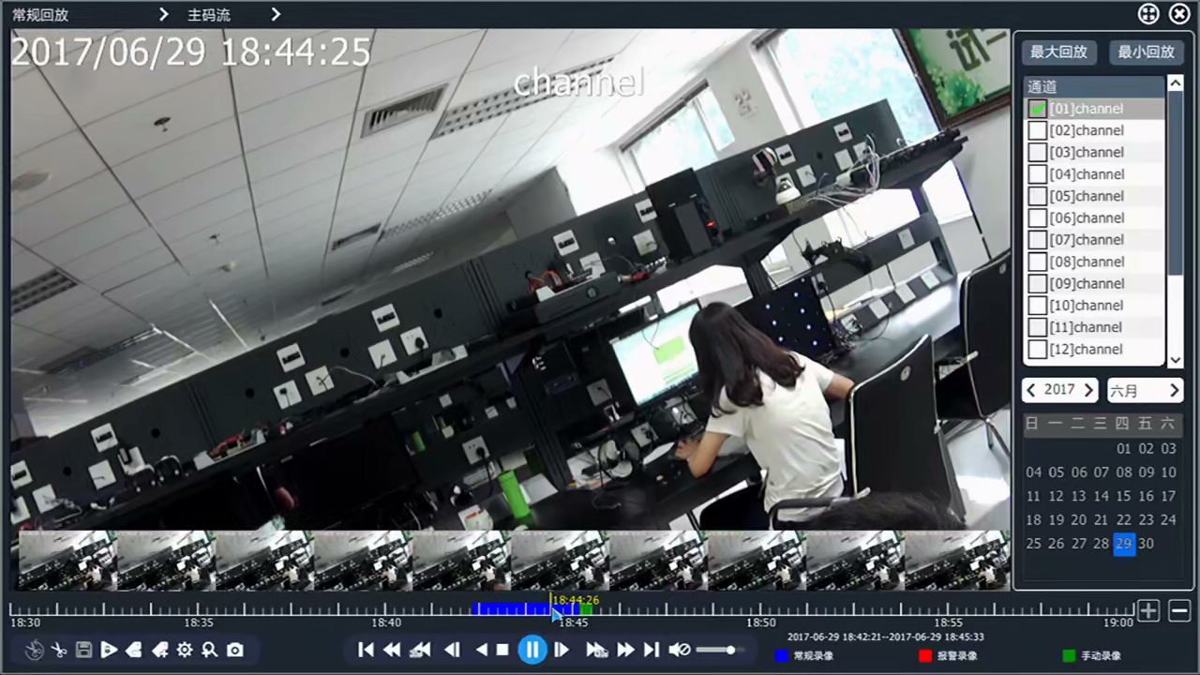
NVR adjustment

Slide 26
Label play back
NVR adjustment
The video tagging function helps users to record the relevant personnel or the scene information at a certain point in time when playing back the video, so as to retrieve the recorded search positioning operation at any time afterwards.

Slide 27
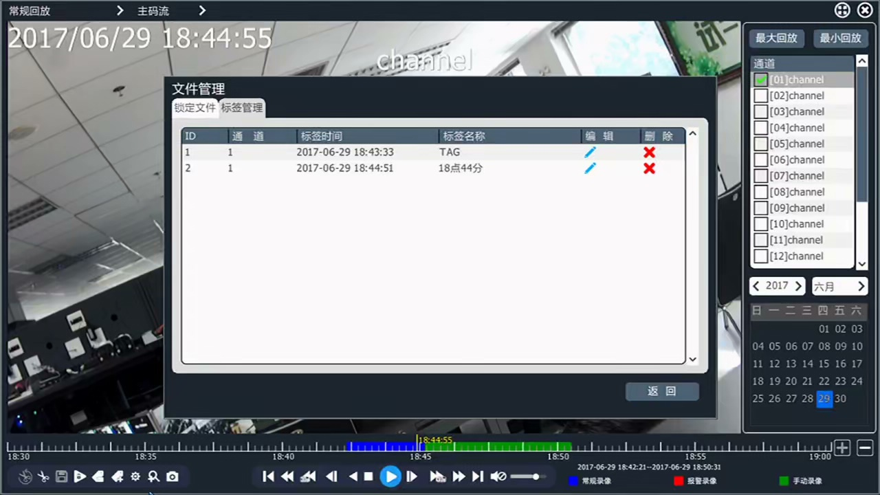
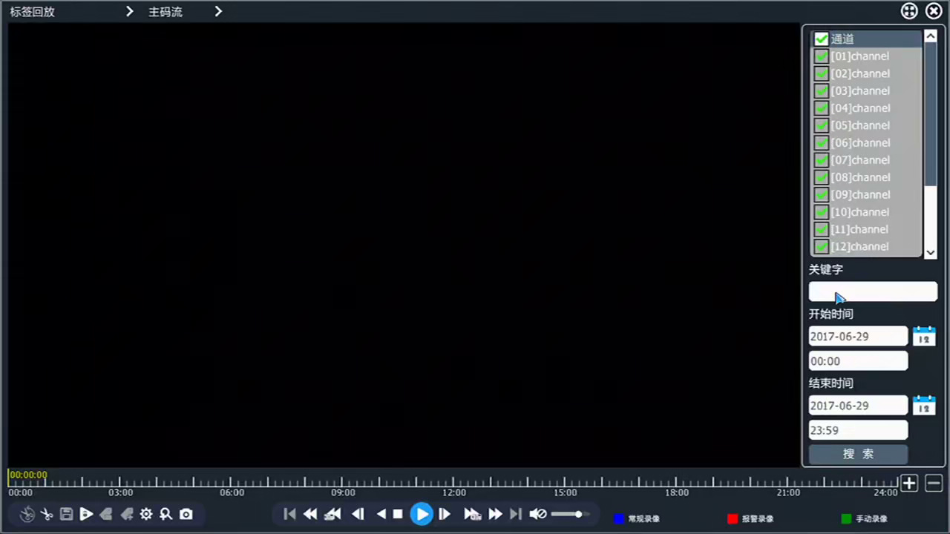
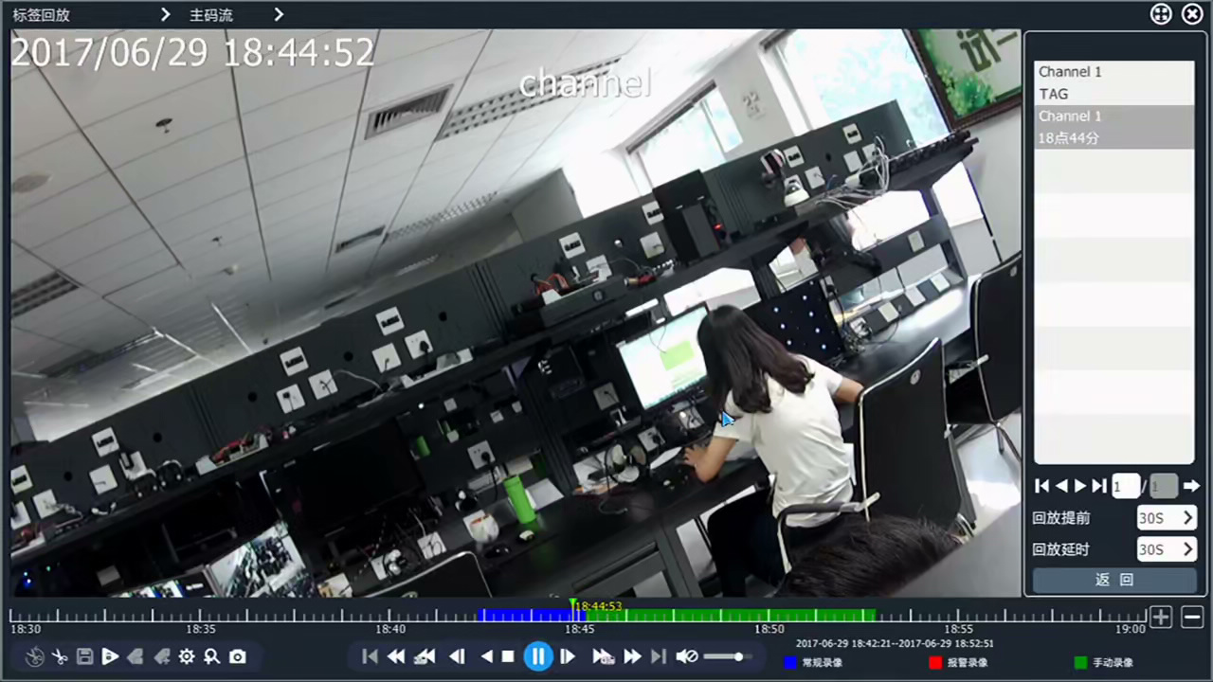
NVR adjustment

Slide 28
NVR adjustment
Smart review
Intelligent analysis of video files to support five intelligent analysis operations such as "Perimeter Search", "Tripwire Search", "Number Statistics", "Face Detection" and "License Plate Recognition".
In the playback interface, select "Intelligent Playback" in playback mode, play the video after selecting the channel and date, and then enter the smart search interface, select the search type, and play the searched video.

Slide 29
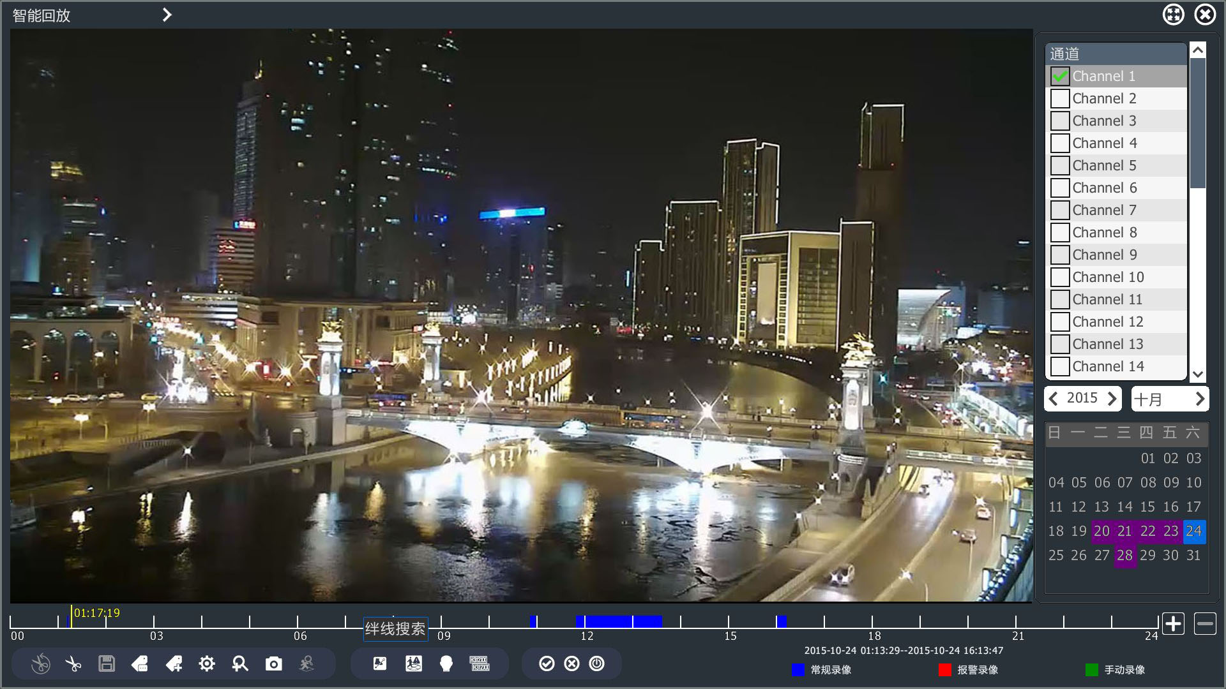
NVR adjustment

Slide 30
NVR adjustment

Slide 31
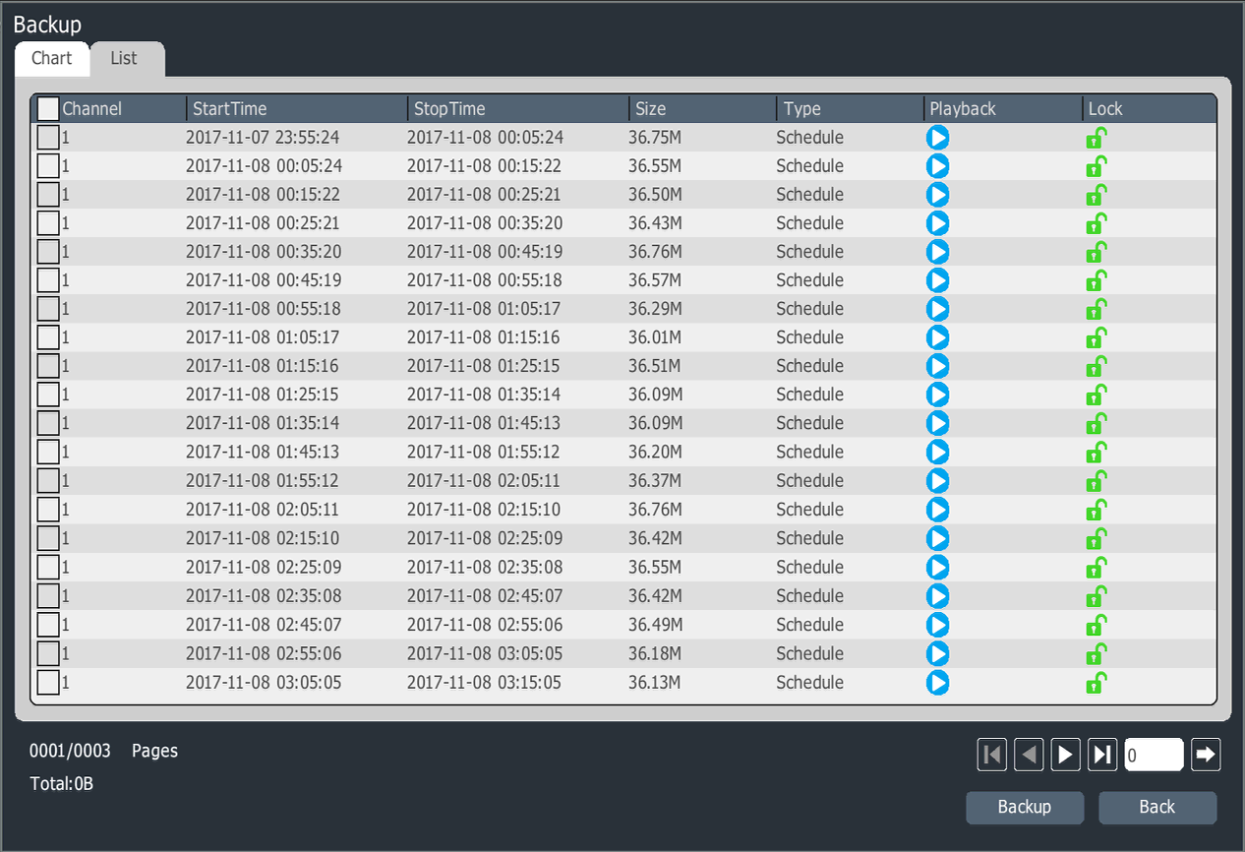
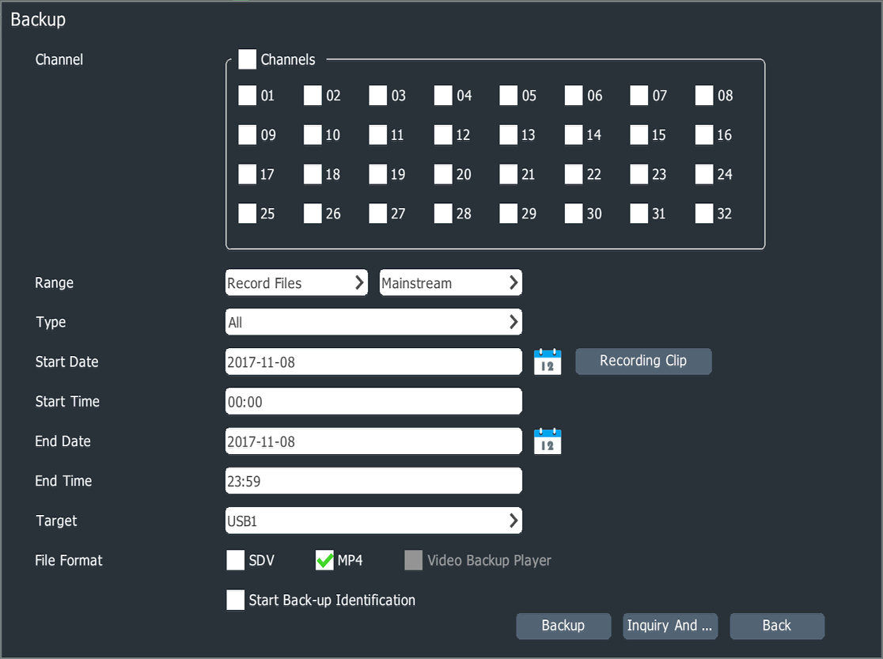
NVR adjustment
NVR Backup video file
Notes:
查询要备份的录像文件，进行备份。

Slide 32
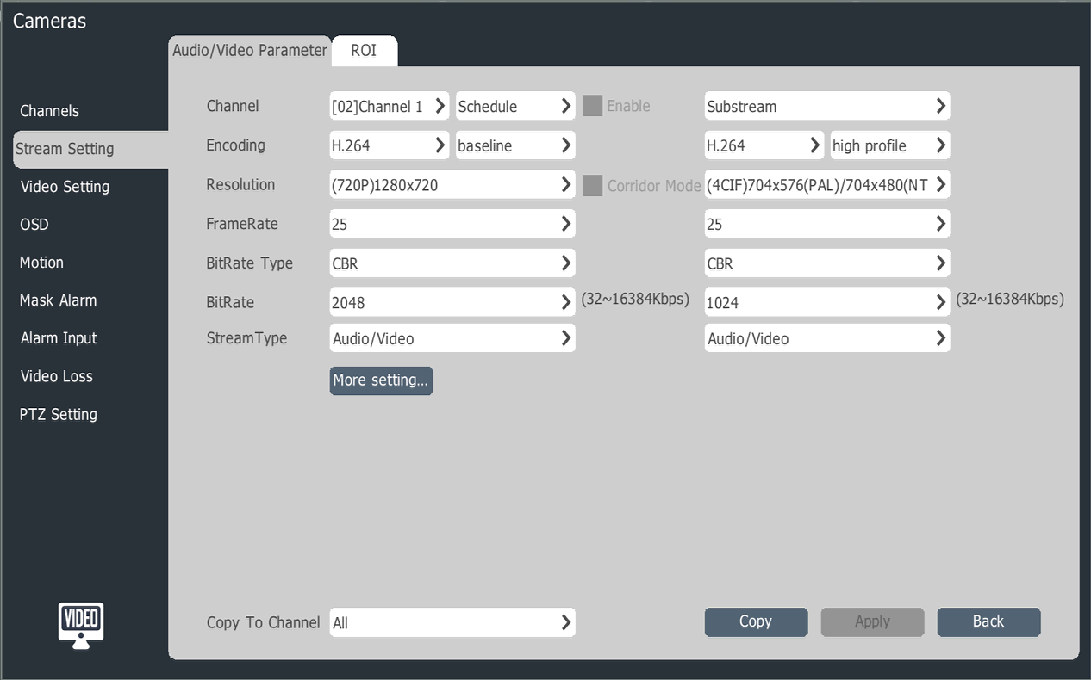
NVR adjustment
Front audio and video parameters set

Slide 33
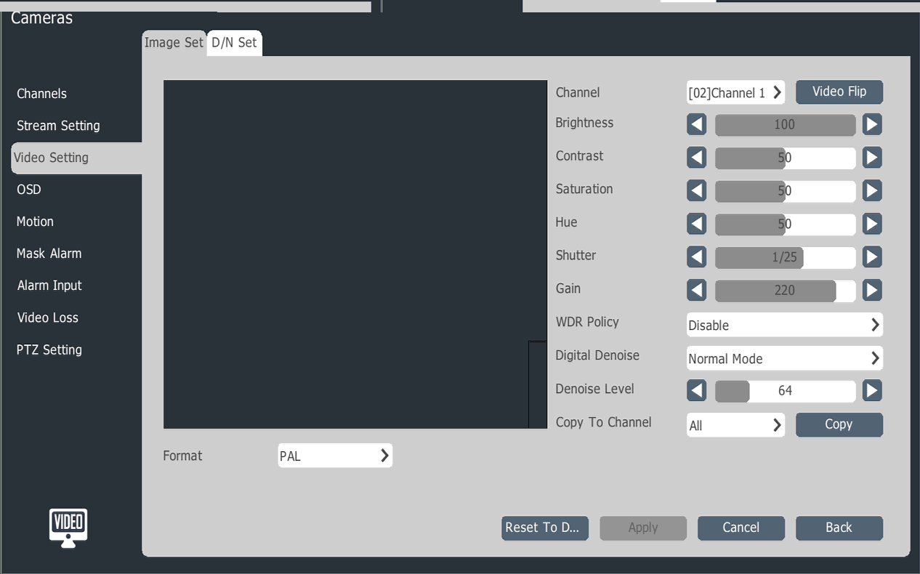
NVR adjustment
Front-end video HD parameter settings

Slide 34
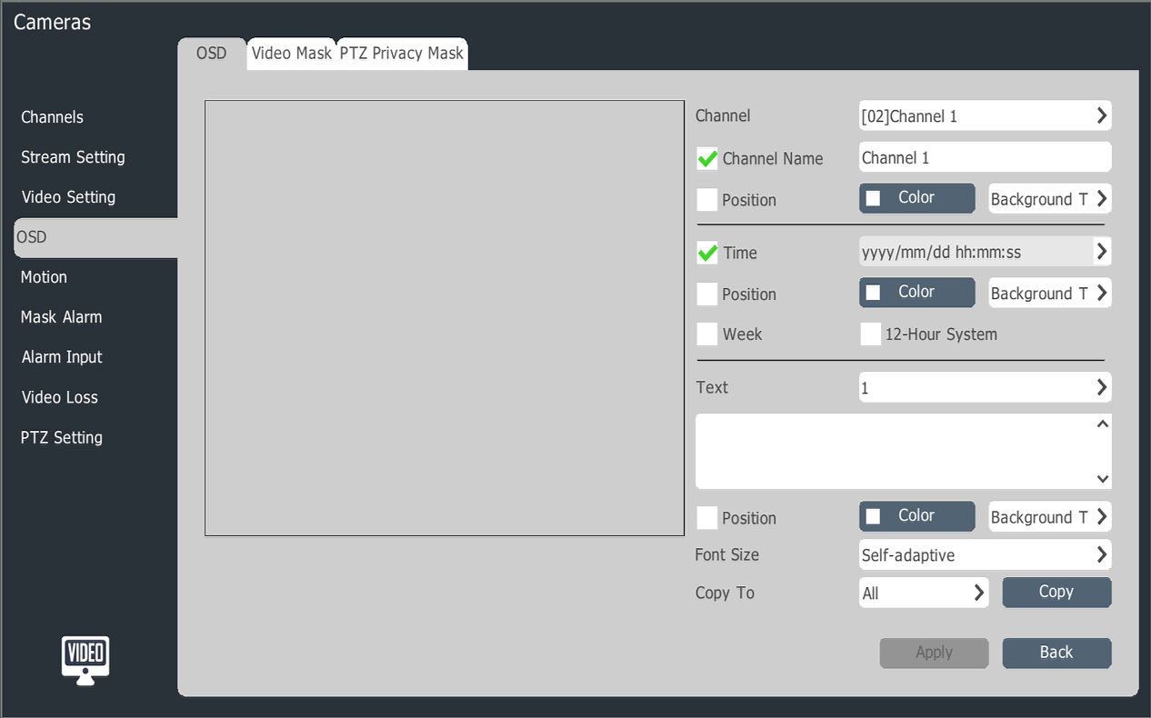
NVR adjustment
OSD setting
Notes:
进入OSD叠加参数设置界面，选择要进行OSD设置的通道、OSD设置、OSD位置。

Slide 35
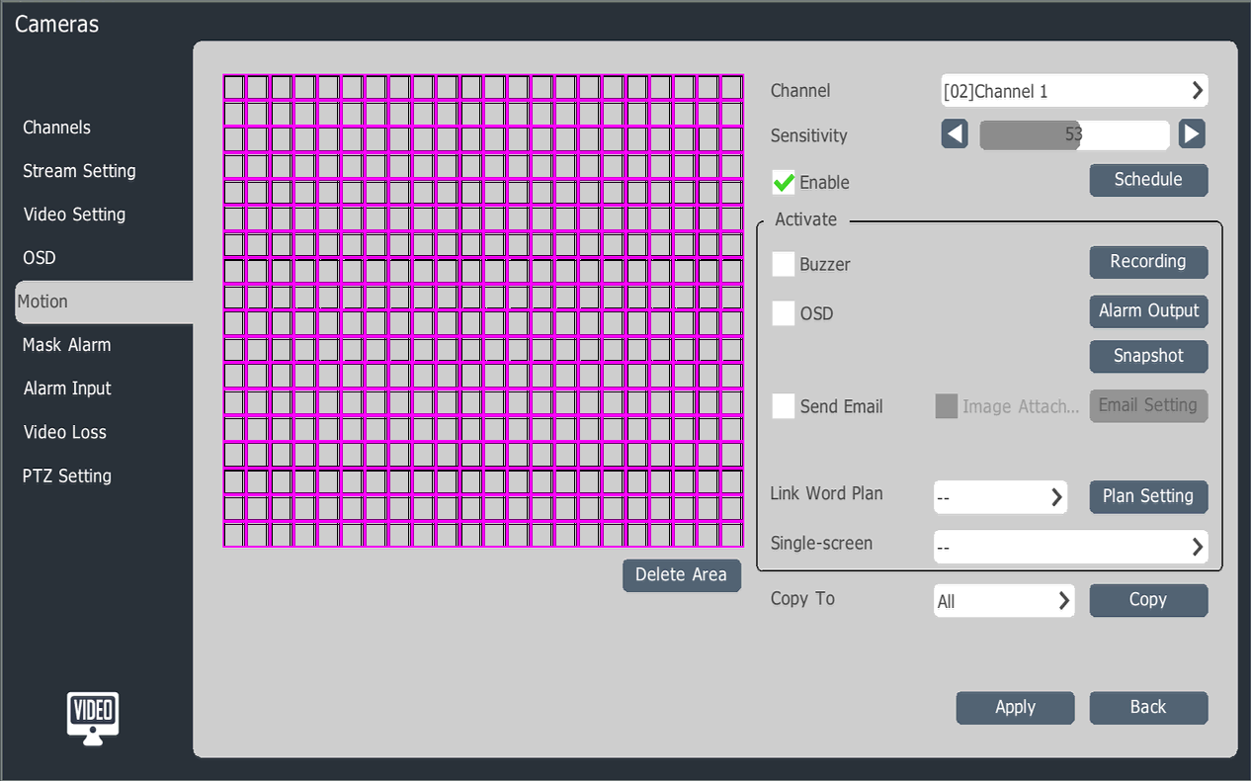
NVR adjustment
Alarm setting
Notes:
设置“移动侦测”、“遮挡报警”、“报警输入”、“视频丢失”四种报警。

Slide 36
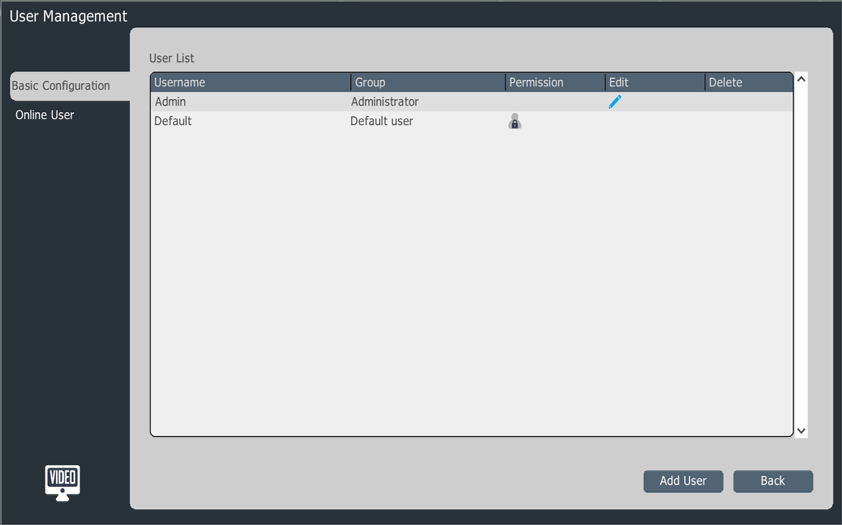
NVR adjustment
用户管理
Notes:
用户管理：进入用户管理界面，选择添加用户，进入“添加用户”界面，可以选择用户归属组、账号、密码。

Slide 37
NVR adjustment
NVR mobile APP
1. Connect the NVR to the public network, enter the monitoring interface of the mobile phone, download the client, and scan the QR code. Follow the prompts to perform video preview and control via the mobile phone.

Slide 38
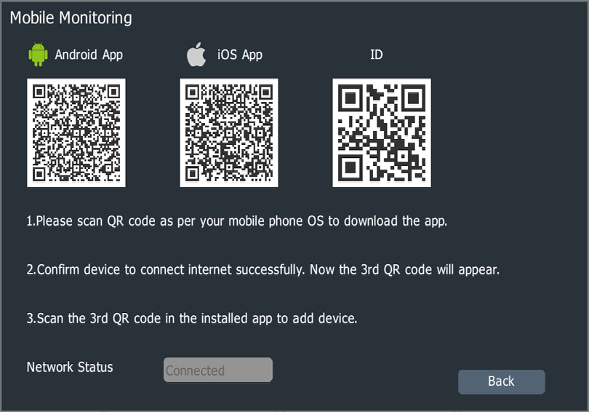
NVR adjustment

Slide 39
NVR adjustment
NVR web GUI Setting
1. Open a browser and enter the IP address of the NVR (default IP address: 192.168.1.3) Enter the user name, password (default username: admin, password: 1111), enter the web interface.
2.Web interface can video preview, video playback, log query, configuration operation.

Slide 40
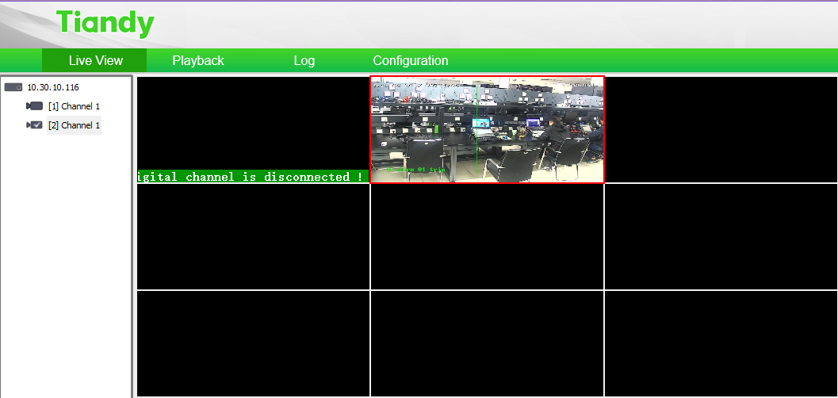
NVR adjustment

Slide 41
Thank You

